Slide 1

Computer Architecture
Course Code: CSE360
Lecture - 5
External Memory

Slide 2
Types of External Memory
Magnetic Disk
  RAID
  Removable
Optical
  CD-ROM
  CD-Recordable (CD-R)
  CD-R/W
  DVD
Magnetic Tape

Slide 3
Magnetic Disk
A disk is a circular platter constructed of non-magnetic material, called substrate, coated with magnetizable material (iron oxide…rust)
Traditionally, substrate has been an aluminium
Now, glass substrate have been introduced
  Improved surface uniformity
    Increases disk reliability
  Reduction in surface defects
    Reduces read/write errors
  Lower flight heights (See later)
  Better stiffness
  Better shock/damage resistance

Slide 4
Read and Write Mechanisms
Recording & retrieval of data via conductive coil called a head
In many systems, there are two heads, a read head and a write head
During read/write, head is stationary, platter rotates
Write
  Electricity flowing through coil produces magnetic field
  Electric pulses sent to write head
  Resulting magnetic patterns are recorded on surface below, with different patterns for positive and negative currents
Read (traditional)
  Magnetic field moving relative to coil produces current in the coil
  Coil is the same for read and write
Read (contemporary)
  Different read mechanism, requires separate read head, positioned close to write head
  The read head consists of a partially shielded magneto resistive (MR) sensor
  The MR material has an electrical resistance that depends on direction of magnetic field
  By passing current through MR sensor, resistance changes are detected as voltage signals
  The MR design allows high frequency operation which equates to higher storage density and speed

Slide 5
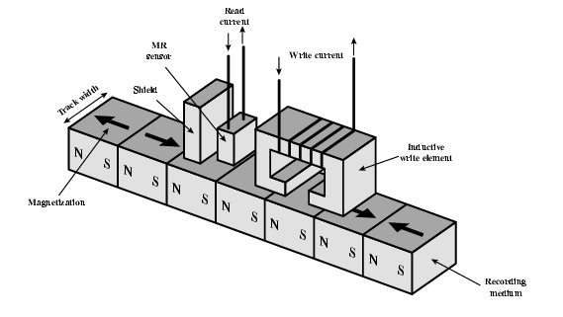
Inductive Write MR Read
Inductive Write
  An electric current in the wire induces a magnetic field, which in turn magnetizes a small area of the recording medium.
  Reversing the direction of current reverses the direction of magnetization on the recoding medium
MR Read
  As discussed in previous slide

Slide 6
Data Organization and Formatting
The head is a small device capable of reading from or writing to a portion of the platter
This gives organization of data on the platter in a concentric set of rings, called tracks (there are thousands of tracks per surfaces)
Adjacent tracks are separated by gaps which prevents or reduces errors due to misalignment of head or simplify interference of magnetic fields
Reduce gap to increase capacity
Data are transferred to or from the disk in sectors
There are hundreds of sectors per track, these may be either fixed or variable length
In most contemporary systems, fixed length sectors are used, with 512 bytes being the universal sector size
To avoid imposing unreasonable precision on system, adjacent sectors are separated by intratrack (intersector) gaps

Slide 7
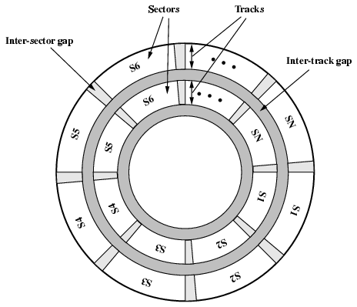
Disk Data Layout

Slide 8
Disk Velocity
A bit near centre of rotating disk travels a fixed (such as read-write head) point slower than a bit on outside of disk
Need to compensate for the variation in speed so that head can read all bits at the same rate
This can be done by increasing spacing between bits in different tracks
The information can then be scanned at the same rate by rotating disk at fixed speed, known as constant angular velocity (CAV)
  Disk is divided into pie-shaped sectors and concentric tracks
  Individual blocks of data can be directly addressed by track and sector
  To move the head from its current location to a specific address, it only takes short movement of the head to a specific track and short wait for given sector
  Waste of space on long outer tracks
    Lower data density (the amount of data stored on long outer tracks is same as what can be stored on short inner tracks)

Slide 9
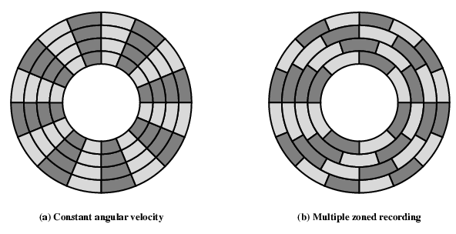
Disk Layout Methods Diagram
To increase density, modern hard disk systems use a technique known as multiple zone recording, in which the surface is divided into number of concentric zones (16 is typical)
  Each zone has fixed bits per track
  Zones farther from centre contain more bits (more sectors)
  This allows greater storage capacity at the expense of somewhat more complex circuitry

Slide 10
Finding Sectors
Some means is needed to locate sector positioned within a track
Clearly, there must be some starting point on the track and a way of identifying the start and end of each sector
Thus, the disk is formatted with some extra data used only by disk drive and not available to user

Slide 11
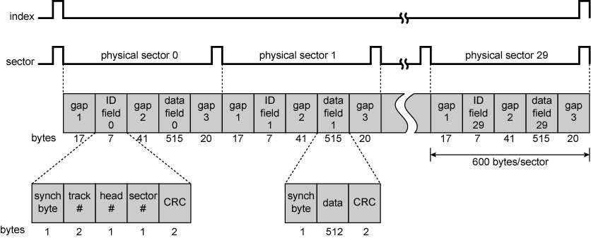
Winchester Disk Format
Seagate ST506
Each track contains 30 fixed-length sectors of 600 bytes each.
- Each sector holds 512 bytes of data plus control information useful to the disk controller
- The ID field a unique identifier or address used to locate a particular sector
- The SYNCH byte is a special bit pattern that delimits the beginning of the field
- The track number identifies a track on a surface
- The head number identifies a head (because disk has multiple surfaces)
- The ID and data fields each contain error-detecting code.

Slide 12
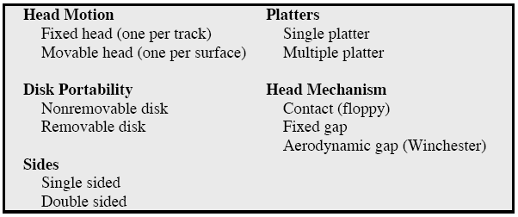
Physical Characteristics of Disk Systems

Slide 13
Fixed/Movable Head Disk
The head may be either fixed or movable with respect to the radial direction of the platter
Fixed head
  One read write head per track
  Heads mounted on fixed ridged arm (rare today)
Movable head
  One read write head per side
  Mounted on a movable arm (because, the head must be able to be positioned above any track)

Slide 14
Removable or Not
The disk itself is mounted in a disk drive, which consists of arm, a spindle that rotates the disk and electronics needed for I/O of binary data
Removable disk
  Can be removed from drive and replaced with another disk
  Provides unlimited storage capacity
  Easy data transfer between systems
  e.g. Floppy disk
Nonremovable disk
  Permanently mounted in the drive
  e.g. hard disk in a personal computer is a nonremovable disk

Slide 15
Sides
For most disks, the magnetizable coating is applied to both sides of platter, which is then referred to as double sided.
Some less expensive disk systems use single-sided disks

Slide 16
Multiple Platter
Some disk drives accommodate multiple platters stacked vertically a fraction of an inch apart.
Multiple-platter disks employ a movable head, with one read-write head per platter surface
All of the heads are mechanically fixed so that all are at the same distance from the centre of the disk and move together
Thus, at any time, all of the heads are positioned over tracks that are of equal distance from the centre of the disk
The set of all the tracks in the same relative position on the platter is referred to as a cylinder.
Data is striped by cylinder
  reduces head movement
  Increases speed (transfer rate)

Slide 17
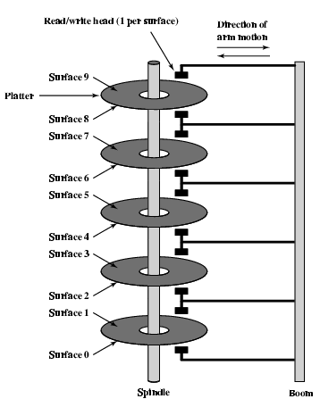
Multiple Platters
The read-write head has been positioned a fixed distance above the platter, allowing air gap
The head actually comes into physical contact with the physical medium during read or write operation (e.g. this mechanism is used with the floppy disk)
The narrower the head is, the closer it to the platter surface
Narrower head means narrower tracks, therefore greater data density
The closer the head to the disk, the greater the risk of error from imperfections
To push the technology further, Winchester disk was developed (see later)

Slide 18
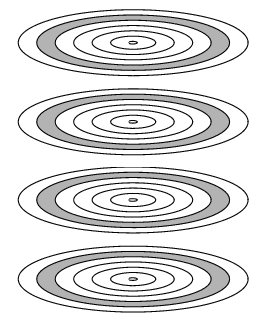
Tracks and Cylinders
All of the shaded tracks are part of one cylinder

Slide 19
Floppy Disk
8”, 5.25”, 3.5”
Small capacity
  Up to 1.44Mbyte (2.88M never popular)
Slow
Universal
Cheap
Obsolete?

Slide 20
Winchester Hard Disk (1)
Developed by IBM in Winchester (USA)
Winchester heads are used in sealed-unit drive with aerodynamic head design
One or more platters (disks)
They are designed to operate closer to the disk’s surface (very small head to disk gap) than conventional rigid disk heads, thus allowing greater data density
The resulting noncontact system can be engineered to use narrower heads that operate closer to the platter’s surface than conventional rigid disk heads.
Getting more robust

Slide 21
Winchester Hard Disk (2)
Universal (Winchester disk is commonly found in personal computers an workstations, where it is referred to as a hard disk)
Cheap
Fastest external storage
Getting larger all the time
  250 Gigabyte now easily available

Slide 22
Disk Performance Parameters: Speed
When the disk drive is operating, the disk is rotating at constant speed. To read or write, the head must be positioned at the desired track and at the beginning of the desired sector on that track.
Seek time
  On a movable-head system, the time it takes to position the head at the track is known as seek time
(Rotational) latency
  Once the track is selected, the disk controller waits until the appropriate sector rotates to line up with the head. The time it takes for the beginning of the sector to reach the head is known as rotational delay.
Access time
The sum of the seek time, if any, and the rotational delay equals the access time (Access time = Seek + Latency), which is the time it takes to get into position to read or write.
Transfer rate
Once the head is in position, the read or write operation is then performed as the sector moves under the head; this is the data transfer portion of the operation and the time for the transfer is the transfer time.

Slide 23
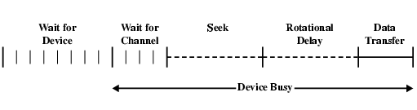
Timing of Disk I/O Transfer
The actual disk I/O operation depend on the computer system, operating system, and nature of I/O channel and disk controller hardware.
In addition to access time and transfer time, there are several queuing delays associated with I/O operation.
When a process issues an I/O request, it must wait first for the device to be available.
At that time, the device is assigned to the process.
If the device shares a single I/O channel or a set of I/O channels with other disk drivers, there may be an additional wait for the channel to be available.
At that point, the seek is performed to begin disk access.

Slide 24
RAID
Redundant Array of Independent Disks
Redundant array of inexpensive disks
7 levels in common use
RAID is a set of physical disk drives viewed by the operating system as a single logical drive.
Data are distributed across the physical drives of an array.
Redundant disk capacity is used to store parity information, which guarantees data recoverability in case of a disk failure.
A parity bit is a bit that is added to a group of source bits to ensure that the number of set bits (i.e., bits with value 1) in the outcome is even or odd. It is a very simple scheme that can be used to detect single or any other odd number (i.e., three, five, etc.) of errors in the output.

Slide 25
RAID 0
No redundancy
Data striped across all disks
Increase speed
  Multiple data requests probably not on same disk
  Disks seek in parallel
  A set of data is likely to be striped across multiple disks

Slide 26
RAID 1
Mirrored Disks
Data is striped across disks
2 copies of each stripe on separate disks
Read from either
Write to both
Recovery is simple
  No down time
Expensive

Slide 27
RAID 2
Redundant via Hamming code
An error-correcting code is calculated across corresponding bits on each data disk
The bits of the code are stored in the corresponding bit positions on multiple parity disks.
Lots of redundancy
  Expensive
  Not used

Slide 28
RAID 3
Similar to RAID 2
Bit-interleaved parity; similar to level 2
But instead of an error-correcting code, a simple parity bit is computed for the set of individual bits in the same position on all of the data disks.
Very high transfer rates

Slide 29
RAID 4
Each disk operates independently
Good for high I/O request rate
Block-interleaved parity
A bit-by-bit parity strip is calculated across corresponding strips on each data disk

Slide 30
RAID 5
Block-interleaved distributed parity
Similar to level 4 but distributes the parity strips across all disks.
Commonly used in network servers

Slide 31
RAID 6
Two parity calculations
Stored in separate blocks on different disks
User requirement of N disks needs N+2
High data availability
  Three disks need to fail for data loss
  Significant write penalty

Slide 32
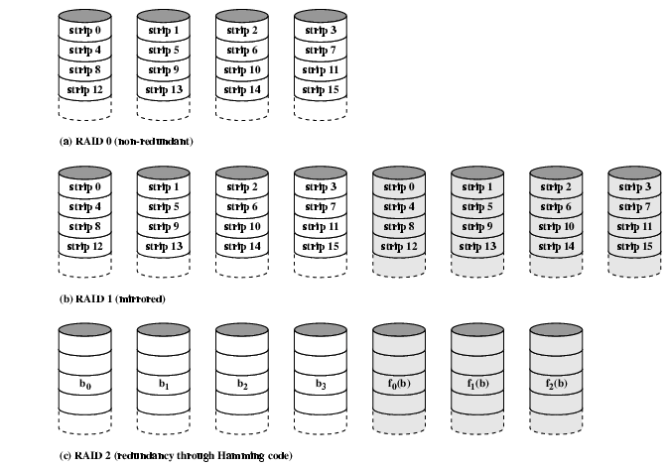
RAID 0, 1, 2

Slide 33
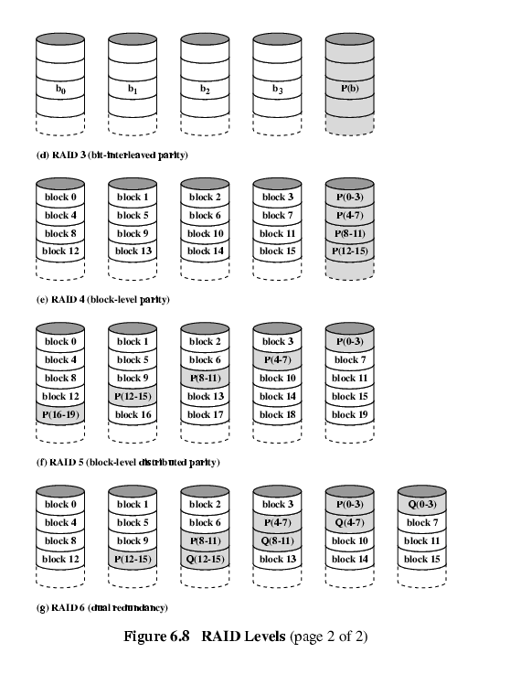
RAID 3 & 4

Slide 34
RAID 5 & 6

Slide 35
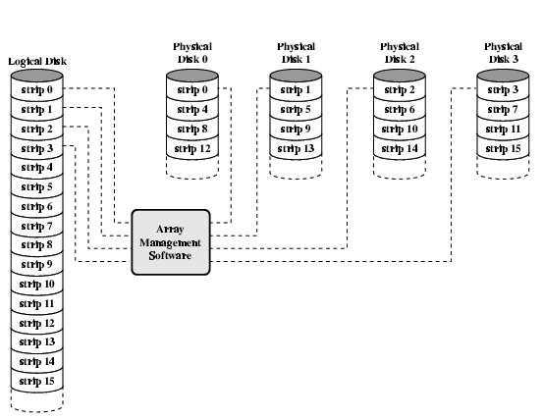
Data Mapping For RAID 0

Slide 36
Optical Storage CD-ROM
Originally for audio
650Mbytes giving over 70 minutes audio
Polycarbonate coated with highly reflective coat, usually aluminium
Data stored as pits
Read by reflecting laser
Constant packing density
Constant linear velocity
At a constant linear velocity (CLV), the disk rotates more slowly for accesses near the outer edge than for those near the center. The capacity of a track and the rotational delay both increase.

Slide 37
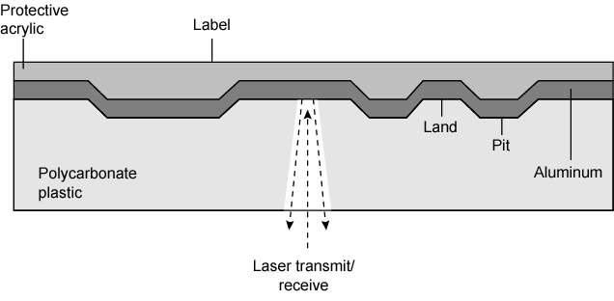
CD Operation

Slide 38
CD-ROM Drive Speeds
Audio is single speed
  Constant linear velocity
  1.2 ms⁻¹
  Track (spiral) is 5.27km long
  Gives 4391 seconds = 73.2 minutes
Other speeds are quoted as multiples
e.g. 24x
Quoted figure is maximum drive can achieve

Slide 39
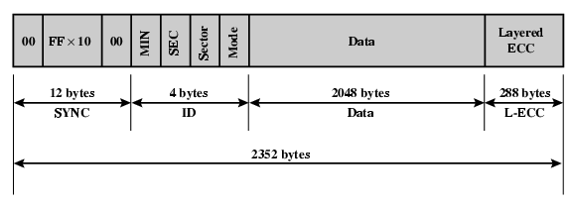
CD-ROM Format
Mode 0=blank data field
Mode 1=2048 byte data+error correction
Mode 2=2336 byte data with no error-correcting code

Slide 40
Other Optical Storage
CD-Recordable (CD-R)
  WORM
  Now affordable
  Compatible with CD-ROM drives
CD-RW
  Erasable
  Getting cheaper
  Mostly CD-ROM drive compatible
  Phase change
    Material has two different reflectivities in different phase states

Slide 41
DVD - what’s in a name?
Digital Video Disk
  Used to indicate a player for movies
    Only plays video disks
Digital Versatile Disk
  Used to indicate a computer drive
    Will read computer disks and play video disks

Slide 42
DVD - technology
Multi-layer
Very high capacity (4.7G per layer)
Full length movie on single disk
  Using MPEG compression
Finally standardized
Movies carry regional coding
Players only play correct region films
Can be “fixed”

Slide 43
DVD – Writable
Lots of trouble with standards
First generation DVD drives may not read first generation DVD-W disks
First generation DVD drives may not read CD-RW disks
Wait for it to settle down before buying!

Slide 44
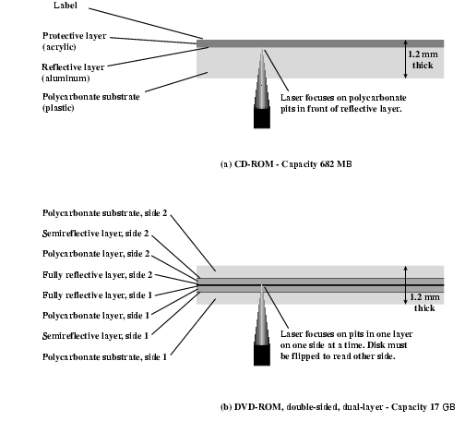
CD and DVD

Slide 45
Magnetic Tape
Serial access
Slow
Very cheap
Backup and archive

Slide 46
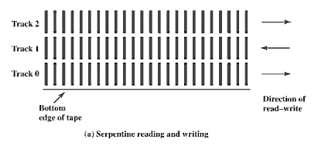
Magnetic Tape Features
The typical recording technique used in serial tapes is referred to as serpentine recording.
When data are being recorded, the first set of bits is recorded along the whole length of the tape.
When the end of the tape is reached, the heads are repositioned to record a new track, and the tape is again recorded on its whole length, this time in the opposite direction. That process continues, back and forth, until the tape is full.

